Slide 1
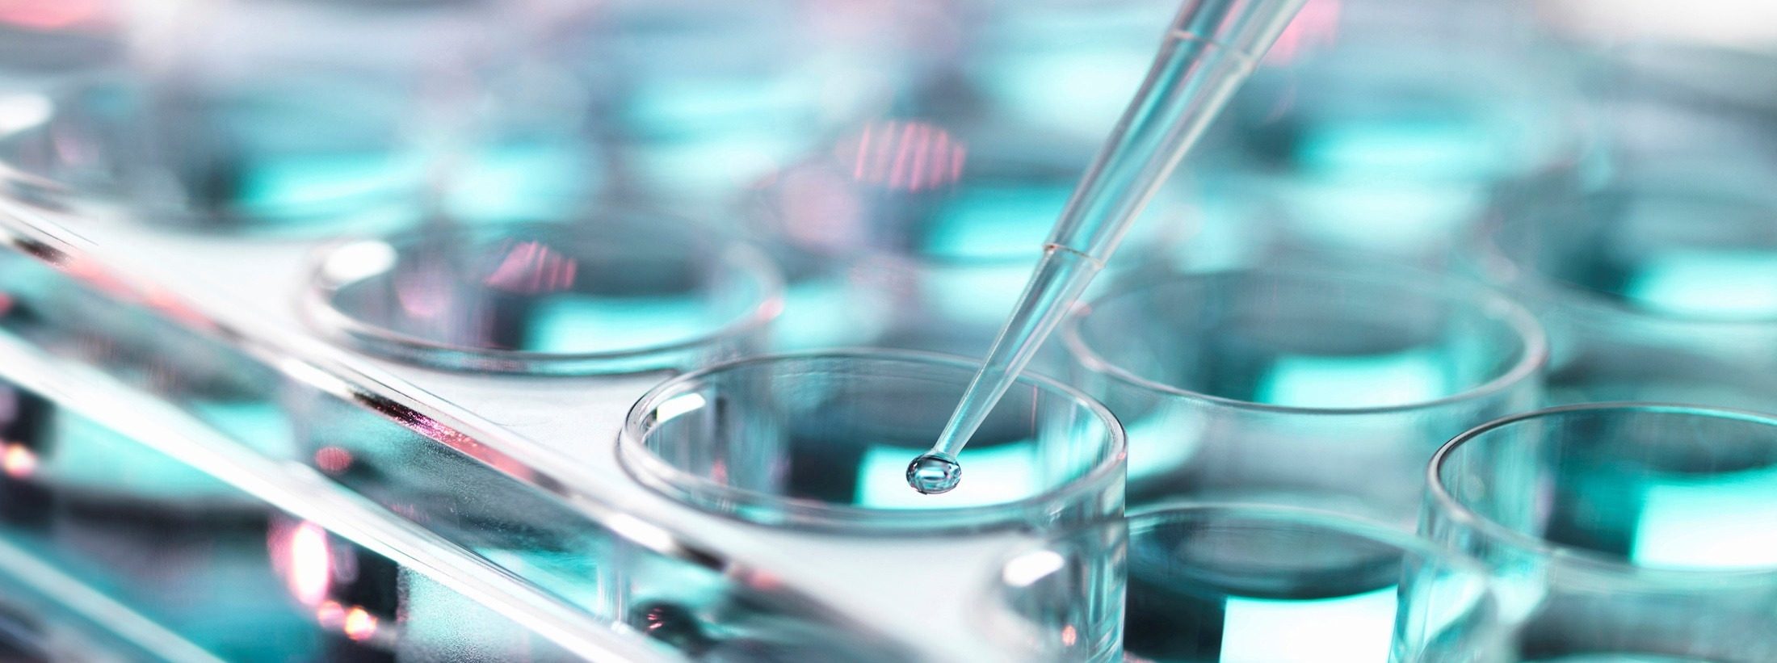
Why do we match blood for patients?
Paul Aerts Scientific Affairs Manager
December 2019

Slide 2
Why do we match blood for patients?
ABO mandatory
RhD mandatory
Mandatory when alloantibodies are present
Beyond what is mandatory
prevention of immunisation
less cost
less delay
less errors (chances of ...)
Antibodies to high incidence antigens
Anti-Vel, -U, -FY3, …
But matching causes delay
Transfusing high spec units when they are not required makes them unavailable when required!

Slide 3
ABO: mandatory
ABO antigens are present on
Red blood cells
Platelets
Many circulating proteins
Many tissues (endothelium, kidney, heart, bowel, pancreas, lung)
Transfusion of ABO-incompatible usually is associated with
Intravascular hemolysis
Renal failure
Death
ABO blood grouping and ABO compatibilty testing are the foundation of all pretransfusion testing

Slide 4
D: mandatory
Most important antigen in the Rh blood group system
Highly immunogenic
> 1/3 of D neg produce anti-D after a transfusion with D pos blood
D pos red cells are usually not tranfused to D neg patients
D pos blood should never be given to
D neg girls
D neg women of child-bearing age
Anti-D causes
HTR
HDFN
D pos blood can be given to
Female patients > 50 yrs (UK), provide they have no (history) of anti-D
Adult males: D neg or D status unknown
Patients undergoing large volume transfusions (> 8 units) EXCLUDING children, females < 50 yrs, and patients with alloanti-D

Slide 5
Patients with alloantibodies
Patients with clinically significant antibodies
Antigen negative units should be selected and IAT crossmatched
Also when the antibody - previously identified – is no longer detectable in the current sample!
Most countries will additionally match in these cases
For RhCE
For K (or routinely would give K-) → to prevent further immunisation

Slide 6
Beyond what is mandatory
Matching for ...?
Matching is not (always) easy (38 systems, close to 400 antigens)
Patient is
DCCee → 20%
K- → 18%
M-S- → 2.7%
Jk(a-) → 0.62%
Fy(a-) → 0.2%
Patient is
DccEE → 2%
K- → 1.8%
s- → 0.18%
Jk(b-) → 0.042%
Fy(b-) → 0.014%
90%
90%
15%
10%
23%
25%
34%
17%
1 in 500!
1 in 7143!

Slide 7
In Asia (numbers may regionally differ)
Patient is
DCCee → 50%
K- → 50%
M-S- → 7.50%
Jk(a-) → 0.62%
Fy(a-) → ???%
Patient is
DccEE → 4.4%
K- → 1.8%
s- → 0.18%
Jk(b-) → 0.042%
Fy(b-) → 0.014%
all
90%
15%
10%
27%
25%
1% or even <
17%
Extremely rare
1 in 7143!

Slide 8
High Risk Groups
Sickle Cell Disease
most frequent genetic disease in France, for instance
15000 known, expected to double over 15 yrs
Most guidelines match for Rh and K (as a minimum)
Black → Rh phenotype Dccee (R₀r)
Up to 47% of them alloimmunize!
Establish full phenotype → genotype (RH, FY, JK, MNS, …)
Match within ethnic group, which is problematic because donor base is predominantly “local”
High rate of RH variants (lacking high incidence antigens) and Fy(a-b-), and U-
Others
MDS: 58% immunisation rate
Thalassemia: 37% immunisation rate
Therapeutic monoclonals (a-CD38, anti-CD47)

Slide 9
High risk groups
Pregnancy
Of course ABO/D mandatory
Immunisation rate comparable to the average (1 to 4%)
Slightly higher for c (RH4)
Relatively high for K (KEL1) mostly from transfusion
Guidelines not identical throughout Europe
Most say: K-
Some say: Rh match (D and CE)
NL specific on c and E

Slide 10
Summary
Matching reduces risks of HTR due to undetectable antibodies (patient history – national databank)
Matching prevents alloimmunization
Benefit for high risk groups
Matching may delay transfusion
Population in some countries becoming more diverse
Donor populations do not always match patient population

