Slide 1
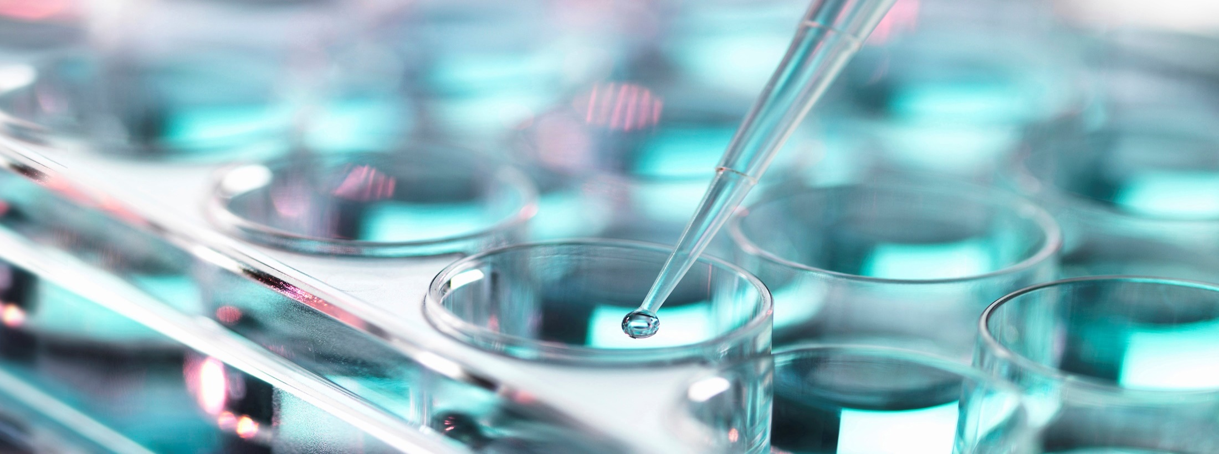
Choose the right anti-D reagent
A piece of cake?
Paul Aerts December 2019

Slide 2
Why is typing for D sometimes so uncertain?
Because of the large number of variables
Variation in D antigen expression
Variation in test methods
The reagents
Different cell lines (clones)
Different reagent formulations
The way the results are interpreted
And sometimes because of the terminology

Slide 3
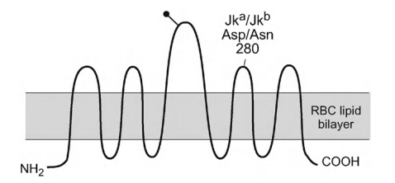
First of all…
The D antigen is NOT a single epitope on a red cell protein, as is the case for instance with Jkª/Jk^{b}
When we type for D we are looking at the presence or absence of an entire protein: RhD
Aspartic acid (Asp) at position 280 = Jkª
Asparagine (Asn) at postion 280 = Jk^{b}
35 amino acid changes from the ancestral RHce gene

Slide 4
2 RH genes: RHD and RHCE

Slide 5
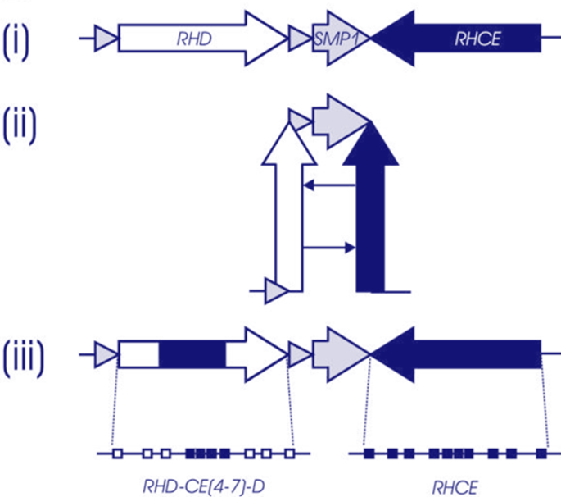
Why so many antigens (55), so many phenotypes
Point mutations (SNV)
Gene conversion
Portions of RHCE into RHD
Portions of RHD into RHCE
And …more
In Feb 2019
More than 500 RHD alleles giving rise to : weak D, partial D, Del
More than 110 RHCE alleles

Slide 6
50 ways to be D negative
Deletion of the RHD gene
Inactive pseudogene (RHDψ)
Hybrid allele RHD*DIIIa-CE(4-7)-D
No RhD protein
D neg
Premature STOP codon
No RhD protein
D neg
3 missense mutations
STOP codon
37bp duplication
1 2 3 4 5 6 7 8 9 10
Protein produced
That does NOT express D
D neg

Slide 7
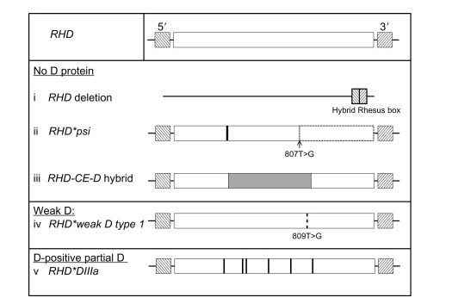
807T>G

Slide 8
Variation of D antigen expression
Three categories
Weak D (mainly, not exclusively, Caucasian)
Decreased antigen expression level; all D epitopes (epD) present
Serology = reacts weaker than expected Weaker than expected → as written in the IFU of the manufacturer
NOT AT RISK of making anti-D
Most common are weak D types 1, 2 and 3 (= result of molecular tests!!)
Partial D (more prevalent Black)
epD’s lacking or altered
Some may react $weakly$and some may also react $strongly$
AT RISK of making clinically significant anti-D
Del (mainly Asian)
Type as D neg, even in IAT; adsorb and elute anti-D
Mutations affecting insertion of the RhD protein
Mainly in Asians: up to 1/3 of serologically D neg are Del
Problem in testing donors
Routine serology cannot distinguish
DNA analysis can distinguish

Slide 9
Some examples of partial D’s
Travels with cE
500 D sites/cell
Travels with Ce
Type 2: 2500 D/cell
Type 3: 13000 D/cell
Type 4: 8000 D/cell
Mainly Caucasian
Almost always linked to RHCE*ce variants
Mainly Black

Slide 10
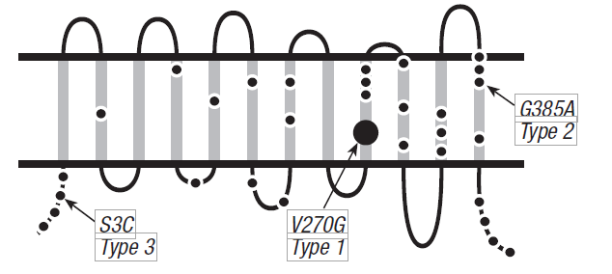
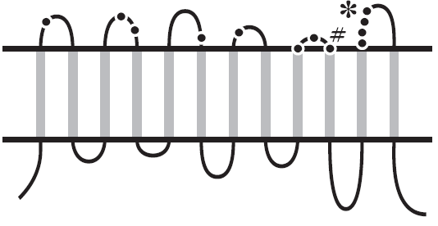
Weak D and partial D on the RhD protein
Weak D
Amino acid changes located in the transmembrane and cytoplasmic regions
Partial D
Amino acid changes located in the extracellular loops
# → partial weak D type 15 ☹ (phenotypes sometimes change category; nomenclature can be confusing
Westhoff CM. Immunohematology 2005;21(4):155-163

Slide 11
Do we know the fequencies of altered RHD?
Ranging from 0.5% to as many as 4%
PAY ATTENTION !
Incidence depends largely on ethnic group
And on technique used
More detail out of References

Slide 12
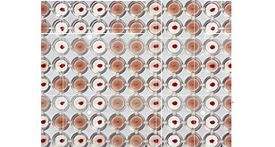
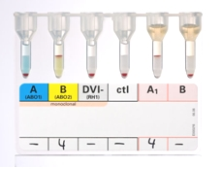
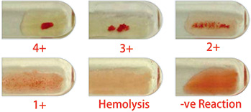
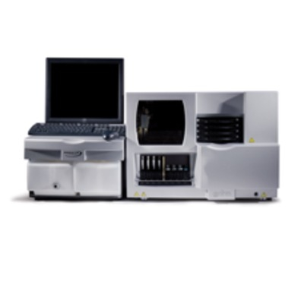
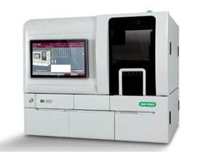
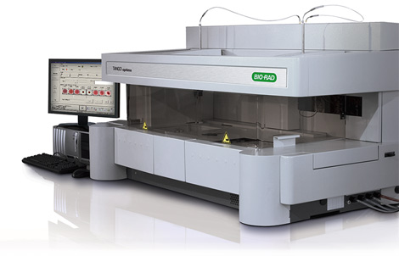
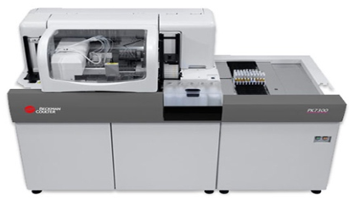
Variation in test methods
Microplates
Solid Phase
Tubes With or without IAT
Automation
Gel cards
Donor Centres
Enzyme treated red cells

Slide 13
EpD (epitope D): a complex story
An epitope can best be understood as an antibody binding site
Rh epitopes (on RhD and RhCE) are conformational
Dependent on the shape of the molecule
Epitopes may involve more than one of the extracellular loops
Changes in the transmembrane parts, may weaken, destroy, or even create new epitopes
Monoclonal antibodies are epD specific
The epD models have evolved from originally a 7 epD model, a 9 epD, … to currently a 37 epD, and more will be added

Slide 14
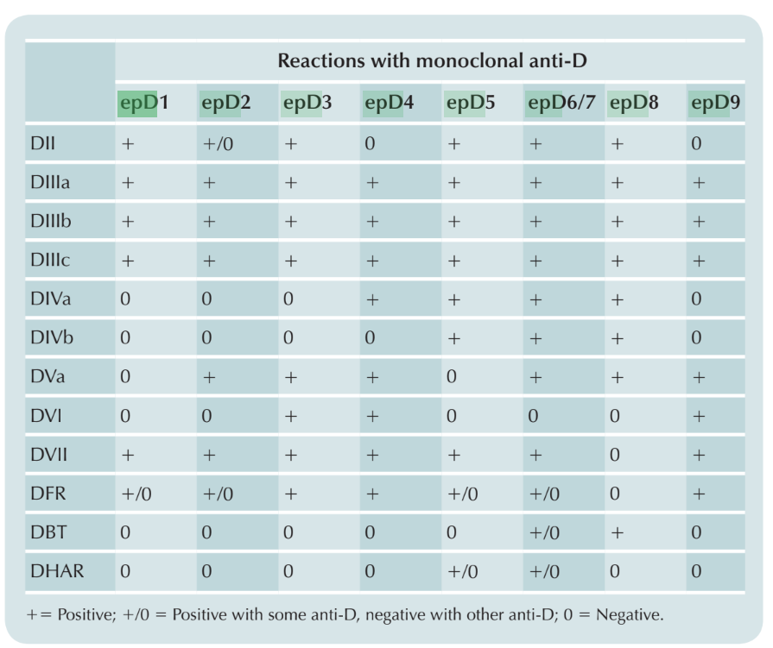
The epD 9 model
Reid ME, Lomas-Francis C, Olsson ML. (2012). The Blood Group Antigen FactsBook. ed. London: Elsevier.

Slide 15
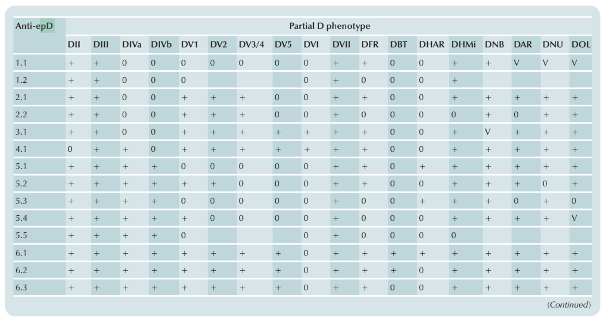
The 30 epD model
Reid ME, Lomas-Francis C, Olsson ML. (2012). The Blood Group Antigen FactsBook. ed. London: Elsevier.

Slide 16
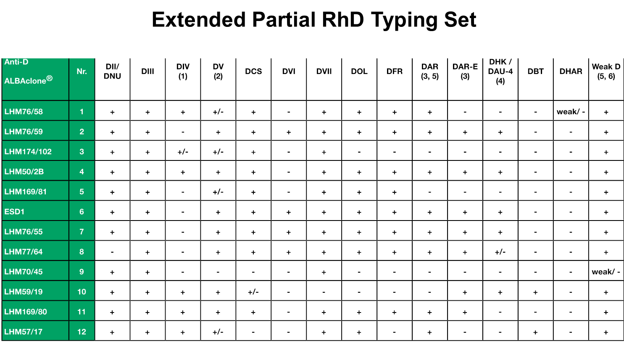
This epD specificity is being used!
Vial ISBT Paris 2001# Cell Line 1-9 1-37 Flegel2007 Wagner 2005
1 74 LHM76/58 8 22
2 76 LHM76/59 36
3 83 LHM174/102 1 2
4 80 LHM50/2B 6/7 15/16 6.3
5 82 LHM169/81 1 1
6 ESD1 4.1
7 75 LHM76/55 3 5 3.1 3.1
8 77 LHM77/64 9 23 9.1
9 79 LHM70/45 1 2 1.2
10 78 LHM59/19 8 22 8.1 8.1
11 81 LHM169/80 6/7 15/16 6.3 6.3
12 LHM57/17 6.3

Slide 17
D Typing donors
IDEALLY All RBCs with any amount of D antigen or D epitopes should be labelled as D pos
REALITY Some weak D’s may be «missed» even in IAT (Del)
Is there a cutoff (number of D sites/cell)?
Not really Reports exist of RBCs with less than $±30$sites/ caused immunization (Transfusion 2005;45:520-6 and 1561-7)
The large number of RBCs in a unit transfused compensate for the low antigen density
Solutions?
Most Del and weak D’s are associated with C and/or E → label r’ and r" units as D pos
Molecular testing on all serologically D neg donors (as in CH, Transfusion 2005;45:527-38)

Slide 18
D Typing patients
IDEALLY All patients at risk for immunisation against the D antigen should be identified
REALITY We discussed a couple of slides ago that serology is not able to distinguish reliably between „normal“ D, partial D and weak D
Compromise We use an anti-D not picking up partial DVI (world wide consensus), and ...?
What about other partial D’s ?
Risk perception !!!
In pregnant women not all countries match for RhCE/K
On average 10% of these women are exposed to c and K
Anti-c, anti-K cause serious HDFN
How do you weigh this risk versus the risk of «missing» something relatively rare in D typing???
!
Slootweg et al. BJOG. 2016 May;123(6):955-63.

Slide 19
History of anti-D reagents
Early reagents were individual anti-D’s from D neg alloimmunized women
!!! Some individuals were D+ with and D- with another
Later antibodies from these women and from hyperimmunized (male and female) volunteers were pooled
Some were IgM and causing direct agglutination
But most were IgG needing
the addition of potentiators
or chemical modification
In the early 80’s monoclonal reagents were introduced
Increased sensitivity → many RBC’s that were weak (in the old we called these D^{u}) now became D pos

Slide 20
US guidelines
It is important to be aware of the differences between guidelines (US and rest of world)
Initially it was proposed (US-FDA) to have different reagents: one for donors, one for patients
But this was seen as too confusing
This is the birth of the “Blends” IgM (monoclonal) + IgG (polyclonal or monoclonal)
In the US anti-D reagents MUST be non-reactive with partial DVI in direct agglutination
these patients type as D neg
Must react with partial DVI on IAT
these donors type as D pos
the practice of “weak D testing”
NOT on patients!

Slide 21
Rest of world guidelines
Virtually all countries have two reagents
Patients → not reacting with partial DVI
Donors → picking up partial DVI
Most require two different monoclonal anti-D’s
NO weak D testing on patients

Slide 22
Interpretation not always helped by IFU
“Reactions <2+ should be evaluated since they can be false positive”
¿Que?
“Agglutination <1+ should be tested using an alternative reagent by IAT prior to final determination”
Patient? Donor?
“Patients should not be classified as D pos on the basis of a weak reaction with a single anti-D”
Sounds reasonable
“If a clear positive is not obtained, it is safer to classify the patient as D neg”
Clear positive = ?
Mentioned many times before by Sue Johnson ☺

Slide 23
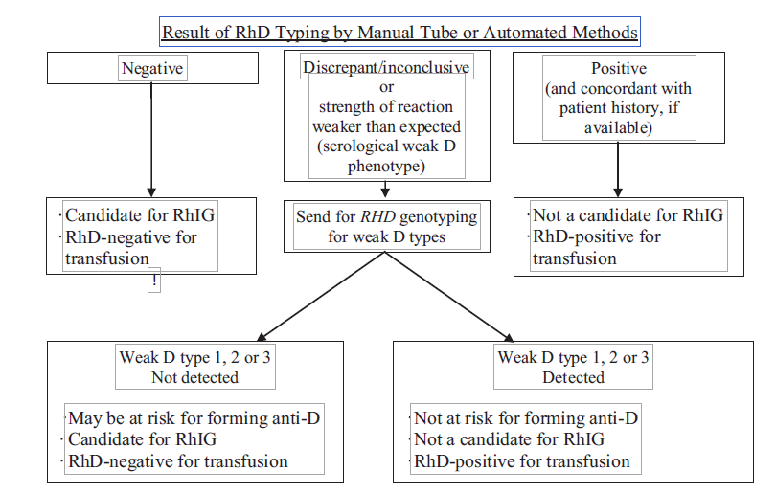
Patients: are we all moving in the same direction?
USA
Sandler SG et al. Transfusion 2015;55:680-689

Slide 24
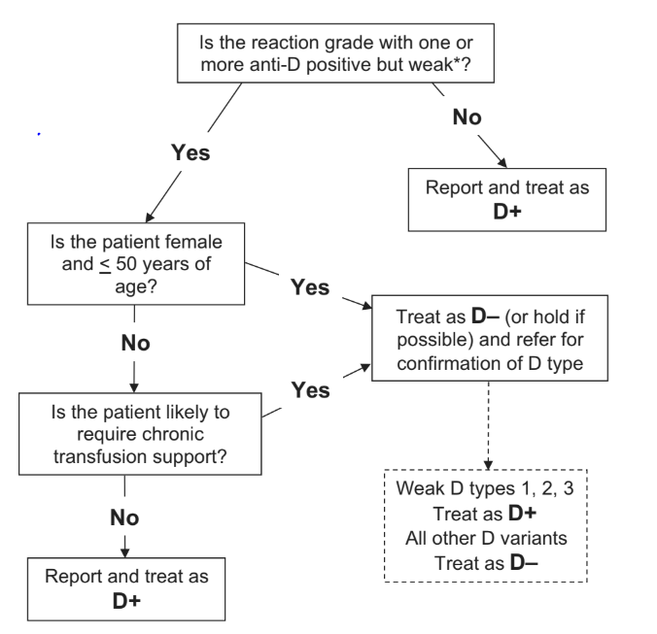
UK: similar
Wilkins C et al. Transfusion Medicine, 2013,23:3–35

Slide 25
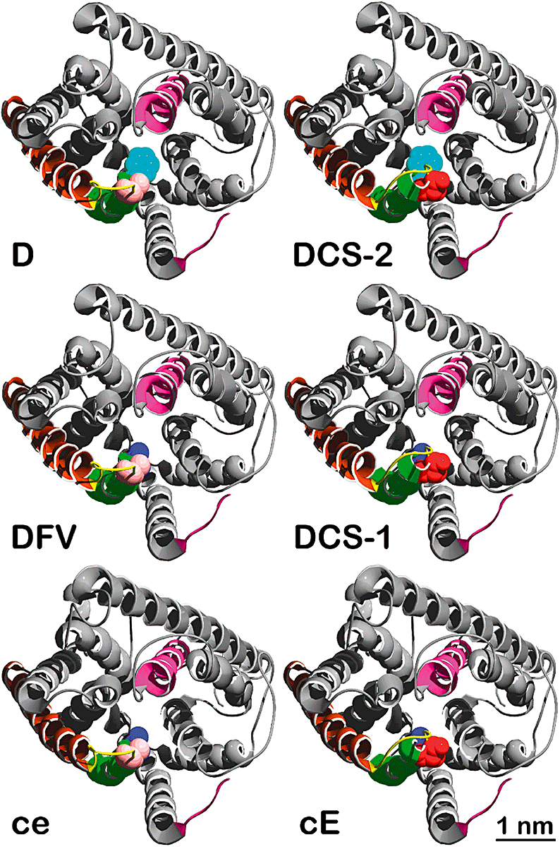
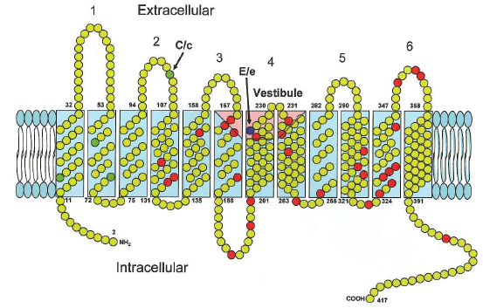
D epitopes expressed in the absence of RHD
Two relatively frequent phenotypes
DHAR (R₀^{Har})
No RHD, no RHCE but
c+, e+w, G-, and pos for two low frequency antigens Rh33 and FPTT
Most IgM cell lines react strongly with DHAR
DHAR persons have produced anti-D
ceCF (Crawford)
Other
RHCE*ceRT, RHCE*ceSL: mimicking epD6
RHCE*ceRG
RHCE*ceAR, without RHD reported in Caucasian

Slide 26
Quizz
RHD gene
RhD protein
D pos
D neg
What does the D stand for?
¿Qué significa la D?

Slide 27
¿Estás de acuerdo? ☺ ☹
DominantE
DiversA
Difícil
Westhoff CM. Immunohematology 2005;21(4):155-163

Slide 28
Aitäh
¿Küsimusi?

Slide 29
Paldies
¿Kādi jautājumi?

Slide 30
Ačiū
¿Turite klausimų?

